Slide 1
Pregnant Shark Wiggle
0852623 Andreas Rony Wijaya

Slide 2
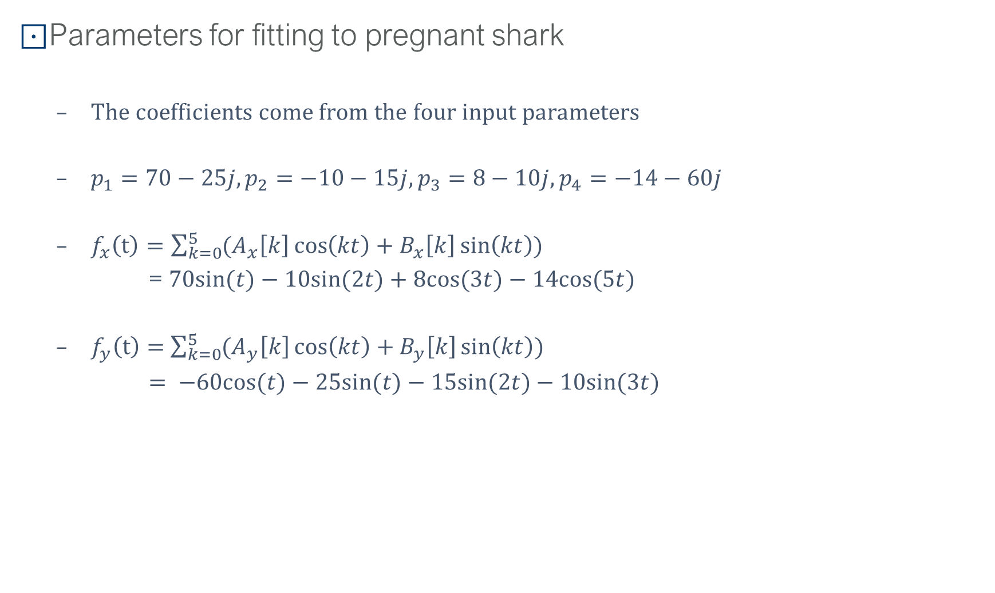
The Fourier Coordinate Expansion
Parameters for fitting to pregnant shark
The coefficients come from the four input parameters
$p_{1}=70−25j, p_{2}=−10−15j, p_{3}=8−10j, p_{4}=−14−60j$
$f_{x}\left(t\right)=\sum_{k=0}^{5}{(A_{x}\left[k\right]\cos\left(kt\right)+B_{x}\left[k\right]\sin\left(kt\right))}$
= $70sin⁡(t)−10sin⁡(2t)+8cos⁡(3t)−14cos⁡(5t)$
$f_{y}\left(t\right)=$ $\sum_{k=0}^{5}{(A_{y}\left[k\right]\cos\left(kt\right)+B_{y}\left[k\right]\sin\left(kt\right))}$
$= −60cos⁡(t)−25sin⁡(t)−15sin⁡(2t)−10sin⁡(3t)$

Slide 3
Python Code to Create The Pregnant Shark
# Pregnant Shark parameters
parameters = [70 - 25j, -10 - 15j, 8 - 10j, -14 - 60j, -20 + 45j]
def fourier(t, C):
f = zeros(t.shape)
for k in range(len(C)):
f += C.real[k] * cos(k * t) + C.imag[k] * sin(k * t)
return f
def shark(t, p):
npar = 6
Cx = zeros((npar,), dtype='complex')
Cy = zeros((npar,), dtype='complex')
Cx[1] = p[0].real * 1j
Cy[1] = p[3].imag + p[0].imag * 1j
Cx[2] = p[1].real * 1j
Cy[2] = p[1].imag * 1j
Cx[3] = p[2].real
Cy[3] = p[2].imag * 1j
Cx[5] = p[3].real
x = append(fourier(t, Cy), [p[4].imag])
y = -append(fourier(t, Cx), [-p[4].imag])
return x, y
def init_plot():
# draw the body of the shark
x, y = shark(linspace(2 * pi + 0.9 * pi, 0.4 + 3.3 * pi, 1000), parameters)
for ii in range(len(y) - 1):
y[ii] -= sin(((x[ii] - x[0]) * pi / len(y))) * sin(float(0)) * parameters[4].real
head.set_data(x, y)
return head,

Slide 4
Python Code to Move The Head and Tail of Pregnant Shark
# move the head and tail
def move_head(i):
x, y = shark(linspace(1.9 * pi + 0.9 * pi, 0.4 + 4.6 * pi, 1000), parameters)
# move head to new position (but don't move eye stored at end or array)
for ii in range(len(y) - 1):
y[ii] -= sin(((x[ii] - x[0]) * pi / len(y))) * sin(float(i)) * parameters[4].real
head.set_data(x, y)
return head,
fig, ax = plt.subplots()
# initial the shark body
x, y = shark(t=linspace(0.4 + 1.3 * pi, 2 * pi + 0.9 * pi, 1000), p=parameters)
plt.plot(x, y, 'b.')
plt.xlim([-95, 100])
plt.ylim([-100, 100])
plt.axis('off')
head, = ax.plot([], [], 'b.') # initialize head
ani = animation.FuncAnimation(fig=fig,
func=move_head,
frames=1000,
init_func=init_plot,
interval=500,
blit=False,
repeat=True)

Slide 5
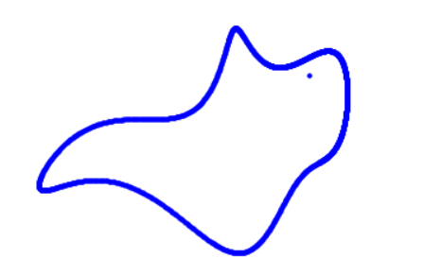
Results: The Pregnant Shark

Slide 6
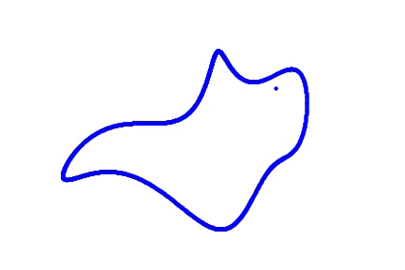
Results: The Pregnant Shark Wiggle mp4

